Slide 1
Bank Loan Default Risk Analysis
Sardar Jagpreet Singh

Slide 3
Basic Information of Dataset:
Dataset contains historical information about loan applications and their repayment status.
This Dataset contains 122 Columns
Total no of rows(applicants) are 307,511
There are missing vales in this dataset. Imputation techniques of filling missing data discussed with each attribute and removed if attributes are not required.

Slide 4
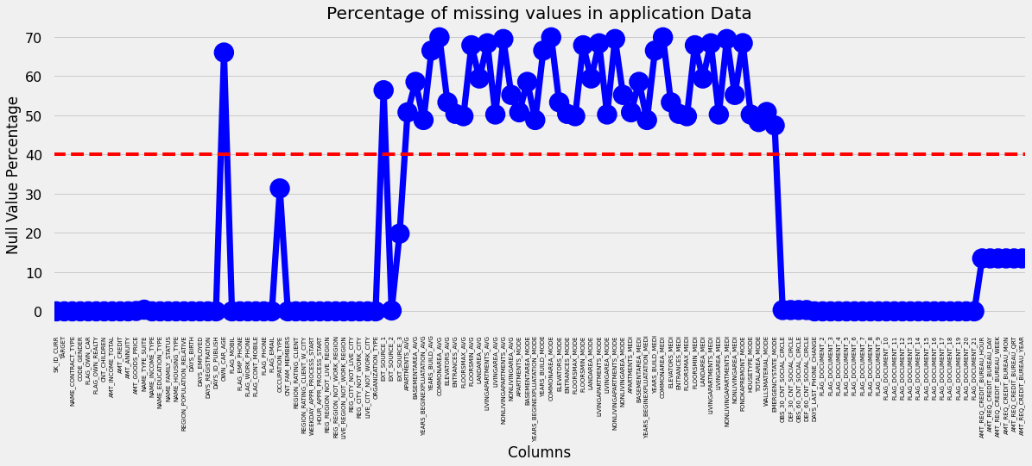
Missing Values Information:
Insights:
In the above graph we can clearly see that there are many columns with missing values more than 40% as marked above the red line and less than 40% marked below the red line.
There are 49 columns with more than 40% of missing values

Slide 5
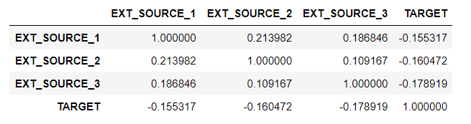
Analyzing columns and deleting unnecessary columns
Insights:
To remove unnecessary columns, first we have to identify is their any correlation exists with independent variable and dependent variable. Here TARGET is a dependent variable and rest are independent variable.
We can clearly see that there is no correlation between independent variables and dependent variables.
We can conclude that above three independent variables are not relevant for our analysis.
Next slide shows clearly about the correlation in more pictorial way.

Slide 6
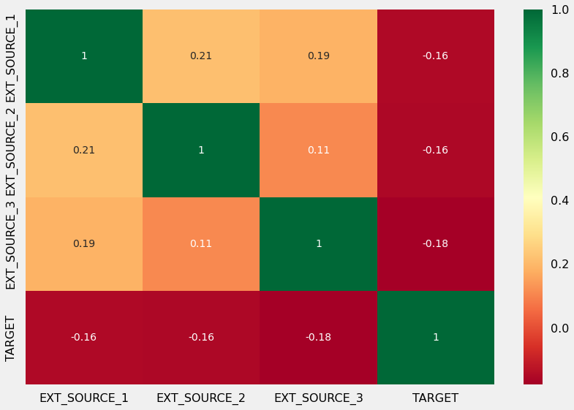
Heat Map:
Insights: Apart from green diagonal there is no correlation exists with target variable, so we can delete independent variables from analysis.

Slide 7
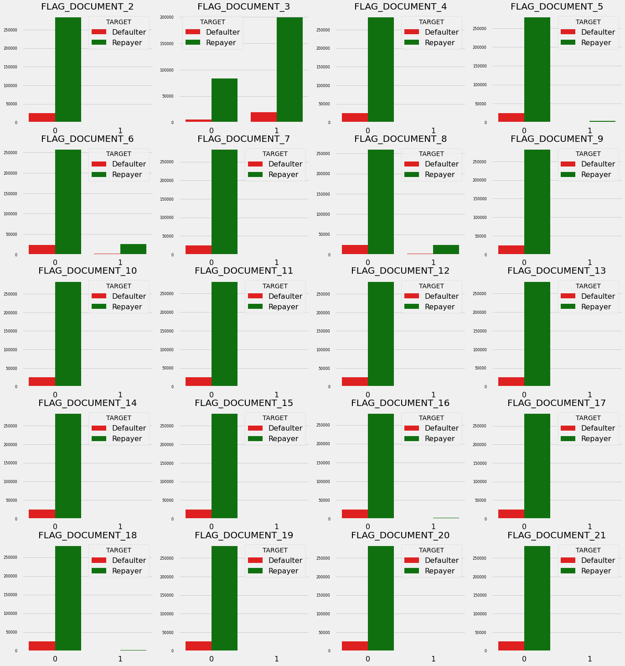
Flag Document:
In the Dataset Flag document are the different types of documents submitted by the borrower.
If the document is submitted then it is consider as 1 and if not submitted it is 0 .
In this picture we can see that clients who had applied for loan has not submitted Flag Document except Flag Document 3.
We can keep Flag Document 3 for analysis and the rest of the Flag Documents are not required.
Data Shows if the borrower submit Flag Document 3 then there are less chances of defaulting the loan.
By including this Flag Document columns except Flag Document 3 column the list of unwanted columns is now 70.

Slide 8
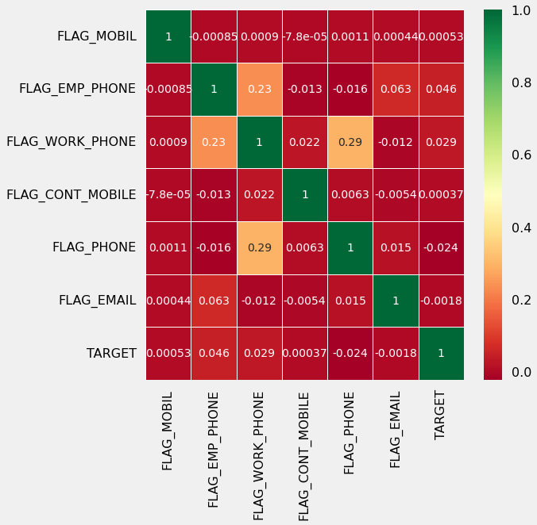
Contact Parameters:
We used contact information to check if there is any correlation exists between contact parameters and loan repayment status.
By plotting heat map it is clear that there is no correlation between Phone, Email and Mobile with Target Variable.
This Contact Parameters are not much useful in our analysis, thus this columns can be deleted from analysis.
Total we have 76 unwanted columns in this data set.
After removing this unwanted columns or irrelevant attributes now we remain with 46 attributes yet to analyze.

Slide 9
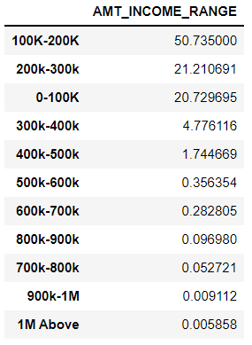
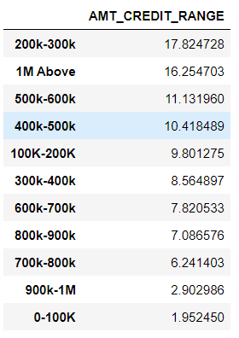
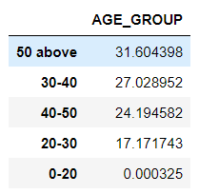
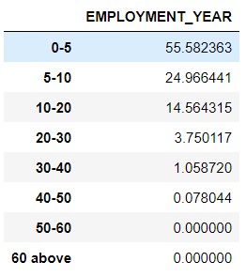
Clients Loan Information:
Insights:
Income range of more than 50% applicants is in between 100K-200K and approximately 92% of applicants income is less than 300K.
More than 16% of applicants have taken loan which amount more than 1Million.
31% of loan applicants age is above 50 years and more than 55% of applicants age is above 40 years.
More than 55% of applicants have a work experience with in 0-5 Years. Almost 80% of them have less than 10 years of work experience.

Slide 10
Data Imputations Strategy:
Categorical Data Imputation Strategy:
To impute null values in categorical variables which has lower null percentage, mode() is used to impute the most frequent items.
To impute null values in categorical variables which has higher null percentage, a new category is created.
Numerical Data Imputation Strategy:
To impute null values in numerical variables which has lower null percentage, median() is used as there are no outliers in the columns.

Slide 11
Implied Imputation Technique on Missing Values
Categorical Attributes:
Variable “NAME_TYPE_SUITE” has missing values of 0.42%. Hence we have used mode strategy to fill missing values with most frequent category.
Feature “OCCUPATION_TYPE” has a higher null percentage of 31.35%. As the null percentage is very high we have created a new category “Unknown” and updated missing values with “Unknown” category.
Numerical Attributes:
Impute numerical variables with the median as there are no outliers that can be seen from results of describe() and mean() returns decimal values and these columns represent number of enquiries made which cannot be decimal:

Slide 12
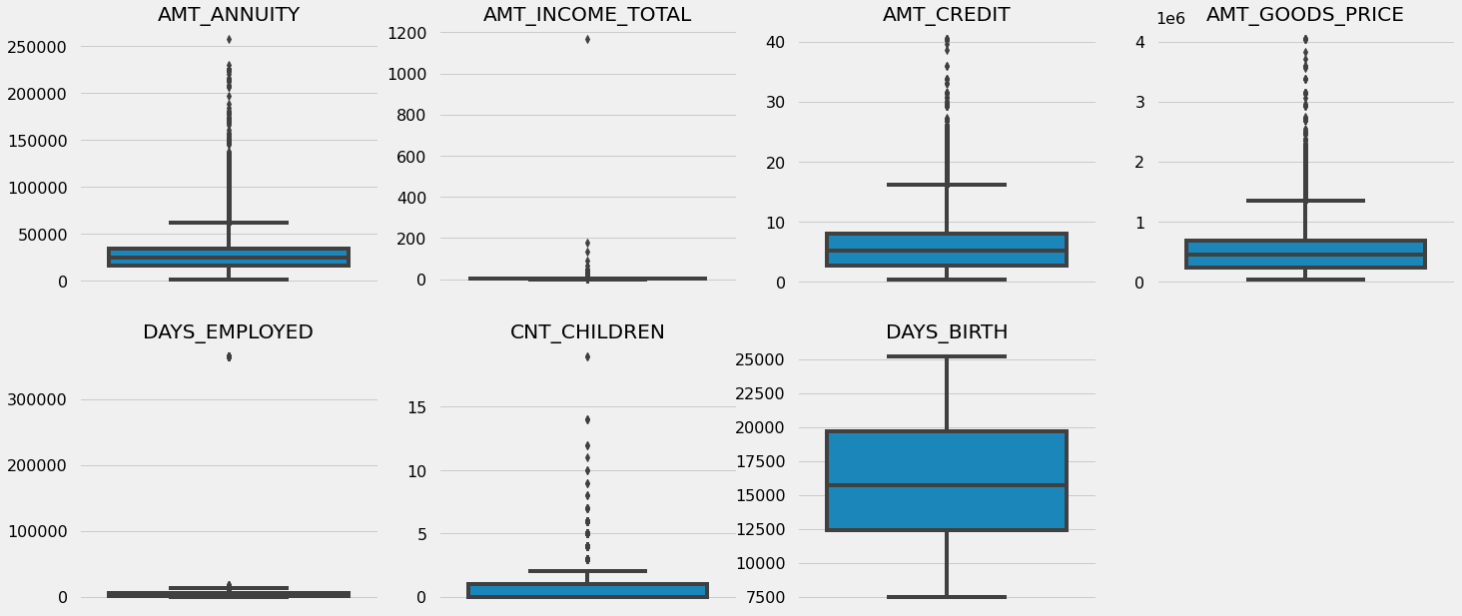
Identifying Outliers:
Insight:
It can be seen that in current application data AMT_ANNUITY, AMT_CREDIT, AMT_GOODS_PRICE,CNT_CHILDREN have some number of outliers. AMT_INCOME_TOTAL has huge number of outliers which indicate that few of the loan applicants have high income when compared to the others.
DAYS_BIRTH has no outliers which means the data available is reliable. DAYS_EMPLOYED has outlier values around 350000(days) which is around 958 years which is impossible and hence this has to be incorrect entry.

Slide 13
Data Analysis:
Strategy:
The data analysis flow has been planned in following way :
Imbalance in Data
Categorical Data Analysis
Categorical segmented Univariate Analysis
Categorical Bi/Multivariate analysis
Numeric Data Analysis
Bi-furcation of databased based on TARGET data
Correlation Matrix
Numerical segmented Univariate Analysis
Numerical Bi/Multivariate analysis

Slide 14
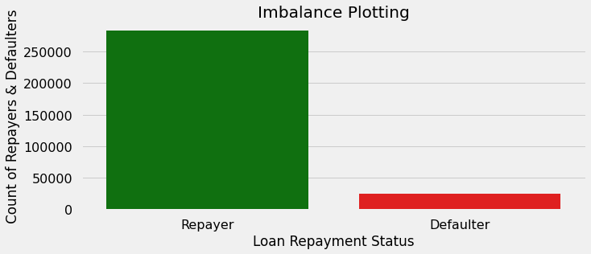
Imbalance Analysis
Insights:
Above graph clearly shows that 91.93% applicants have repaid their loans and 8.07% are defaulters shown in red bar.
The ratio of Re-payer and Defaulter is 11.39 : 1(approximately)

Slide 15
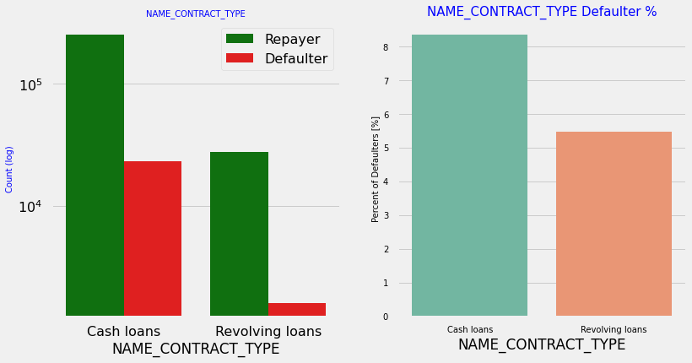
Categorical Variables Analysis
Insights:
Contract type: Revolving loans are just a small fraction (10%) from the total number of loans; in the same time, a larger amount of Revolving loans, comparing with their frequency, are not repaid.

Slide 16
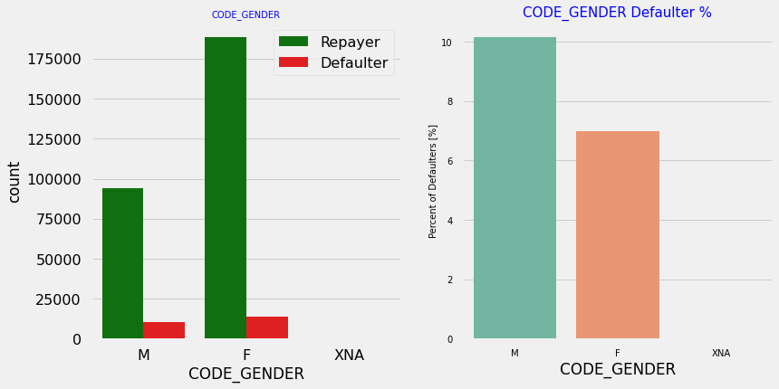
Gender vs Defaulters
Insights:
The number of female clients are double then the male clients.
Based on the percentage of defaulted credits male have a higher chance of not returning their loans (10%), comparing with women(7%).

Slide 17
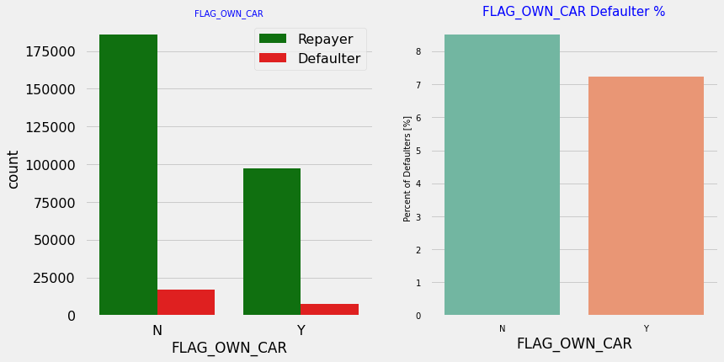
Target vs Client owns a car
Insights:
Clients who own a car are half in number of the clients who don’t own a car, But, based on the percentage of defaulters, there is no correlation between owning a car and the loan repayment as in both the cases the default percentage is almost same.

Slide 18
Target vs Own Realty:
Insights:
The clients who own real estate are more than double of the ones that don't own. But the defaulting rate of both categories are around the same (~8%). Thus there is no correlation between owning a reality and defaulting the loan.

Slide 19
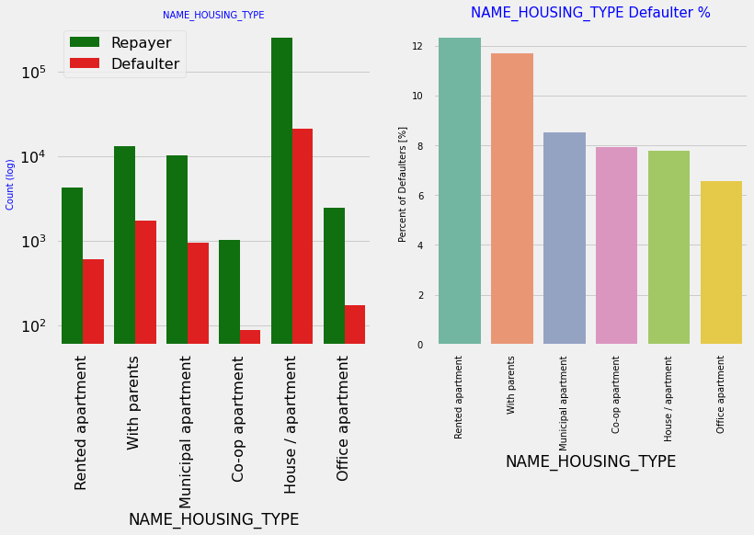
Target vs Housing Type:
Insights:
Majority of people live in House/Apartment.
People living in office apartments have lowest default rate
People living with parents(11.5%) and living in rented apartments(>12%) have higher probability of defaulting.

Slide 20
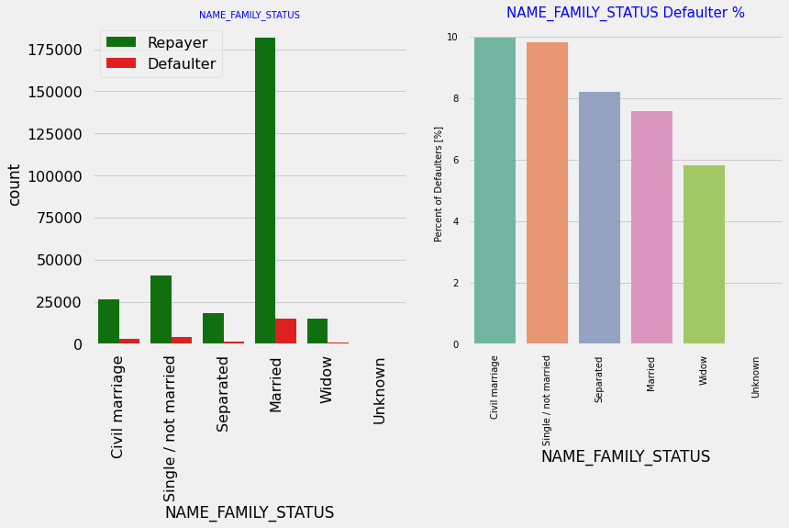
Target vs Family Status:
Insights:
Most of the people who have taken loan are married, followed by single/not married and civil marriage.
In term of percentage of non repayment of loan, Civil Marriage has the highest percentage of non repayment (10%), with widow the lowest(exception being Unknow.

Slide 21
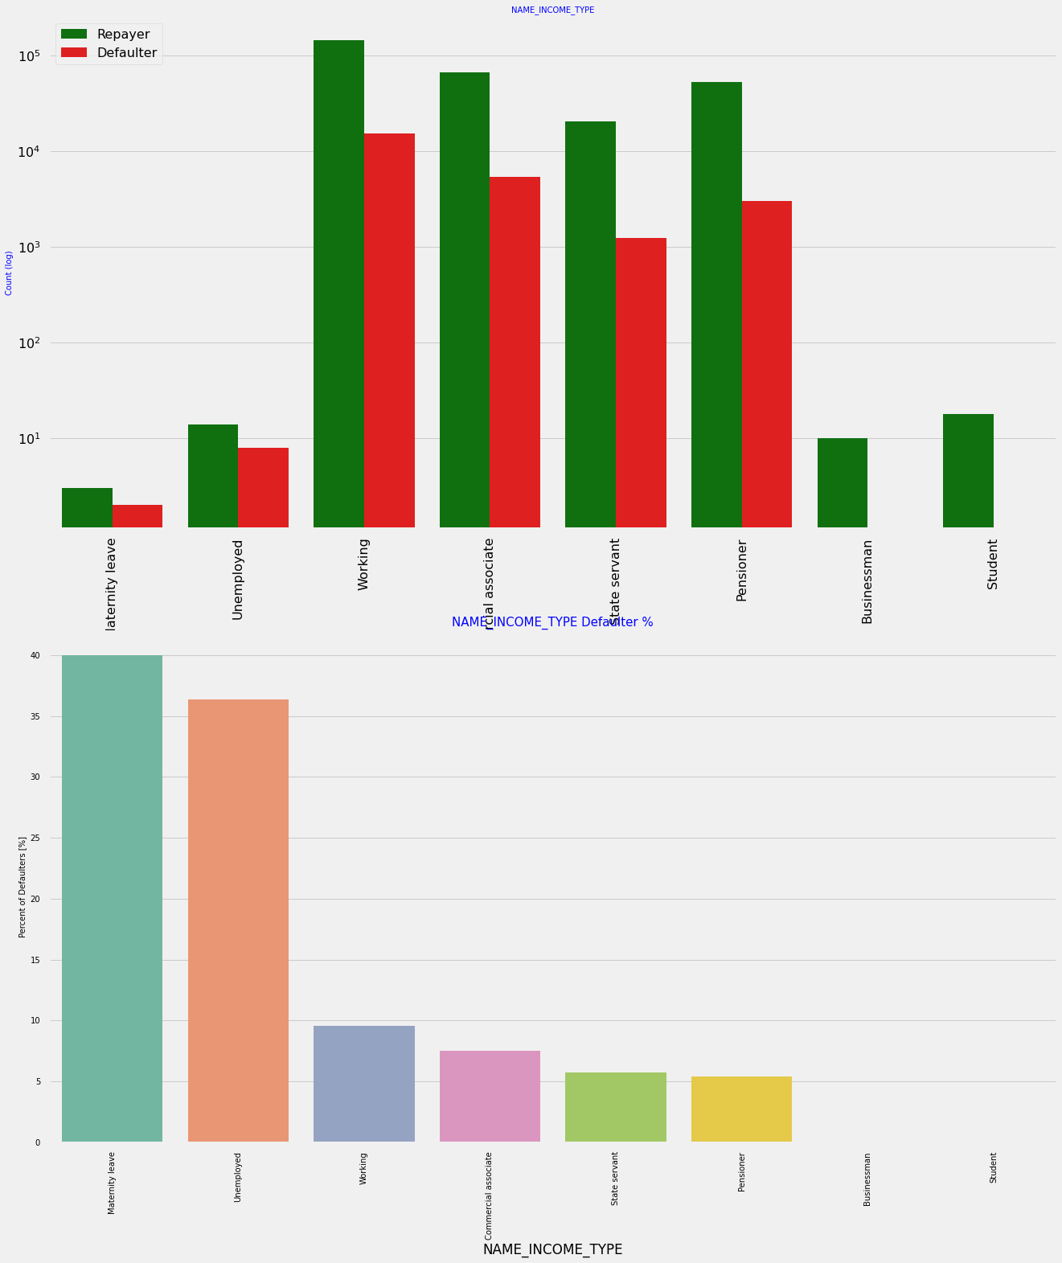
Target vs Income Type:
Insights:
Most of applicants for loans have income type as Working, followed by Commercial associate, Pensioner and State servant.
The applicants with the type of income Maternity leave have almost 40% ratio of not returning loans, followed by Unemployed (37%). The rest of types of incomes are under the average of 10% for not returning loans.
Student and Businessmen, though less in numbers do not have any default record. Thus these two category are safest for providing loan.

Slide 22
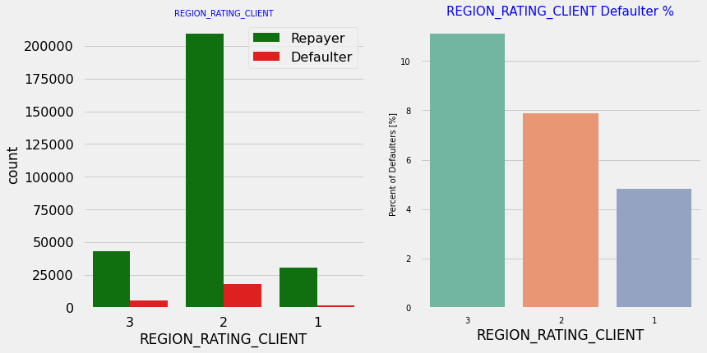
Target vs Region Rating:
Insights:
Most of the applicants are living in Region Rating 2 place.
Region Rating 3 has the highest default rate (11%)
Applicant living in Region Rating 1 has the lowest probability of defaulting, thus safer for approving loans

Slide 23
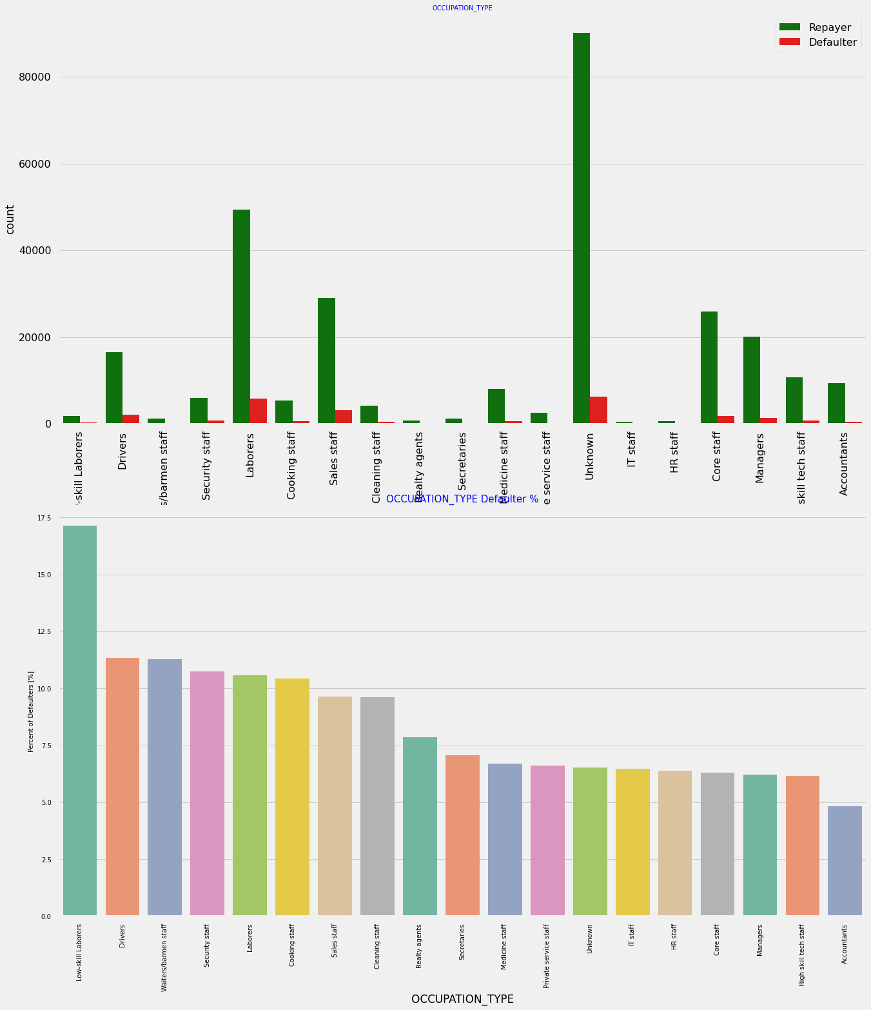
Target vs Occupation:
Insights:
Most of the loans are taken by Laborers, followed by Sales staff. IT staff take the lowest amount of loans.
The category with highest percent of not repaid loans are Low-skill Laborers (above 17%), followed by Drivers and Waiters/barmen staff, Security staff, Laborers and Cooking staff.

Slide 24
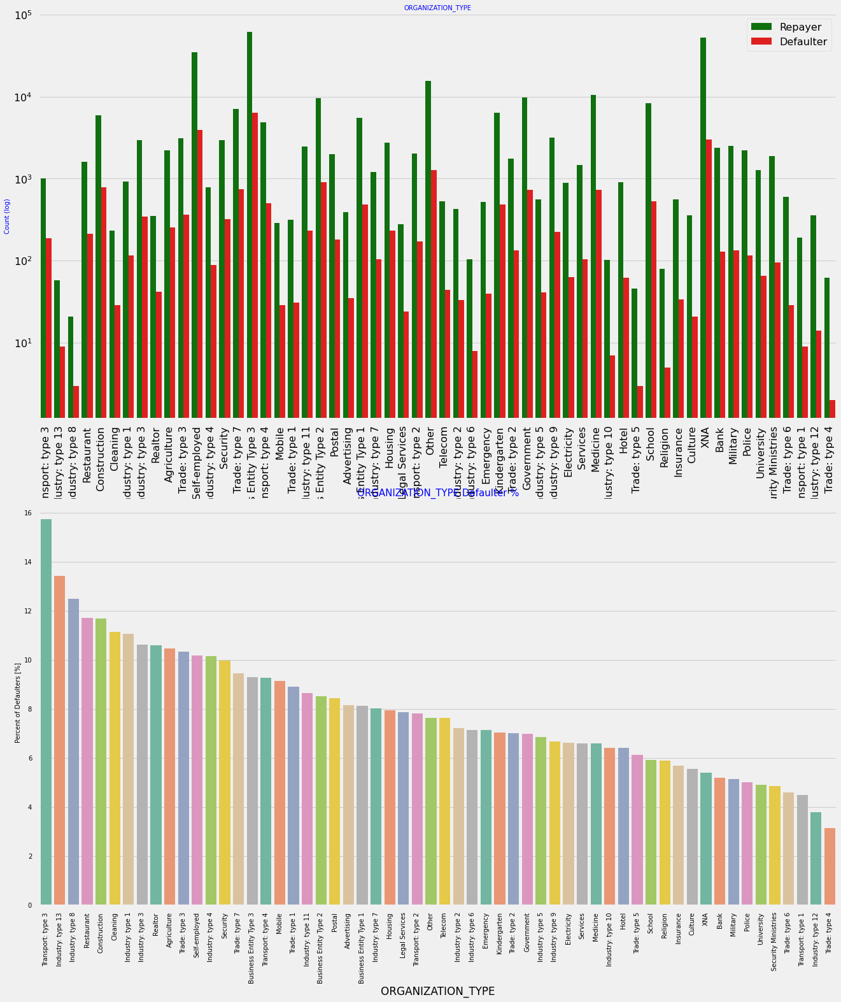
Target vs Organization Type:

Slide 25
Insights:
Organizations with highest percent of loans not repaid are Transport: type 3 (16%), Industry: type 13 (13.5%), Industry: type 8 (12.5%) and Restaurant (less than 12%). Self employed people have relative high defaulting rate, and thus should be avoided to be approved for loan or provide loan with higher interest rate to mitigate the risk of defaulting.
Most of the people application for loan are from Business Entity Type 3
For a very high number of applications, Organization type information is unavailable(XNA).
It can be seen that following category of organization type has lesser defaulters thus safer for providing loans:
Trade Type 4 and 5
Industry type 8

Slide 26
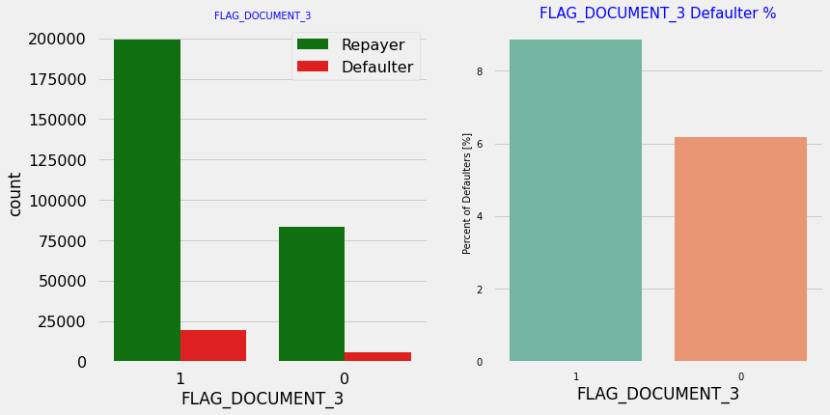
Target vs Flag Document 3:
Insights:
There is no significant correlation between repayers and defaulters in terms of submitting document 3 as we see even if applicants have submitted the document, they have defaulted a slightly more (~9%) than who have not submitted the document (6%)

Slide 27
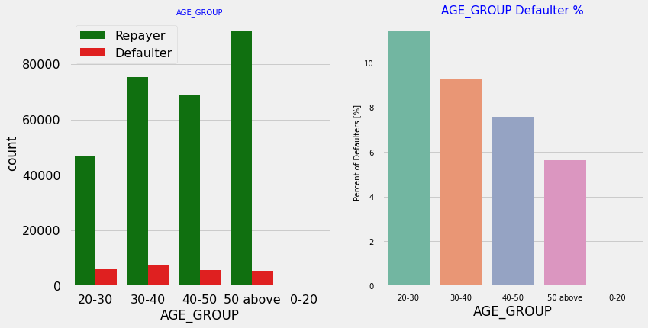
Target vs Age Group:
Insights:
People in the age group range 20-40 have higher probability of defaulting
People above age of 50 have low probability of defailting

Slide 28
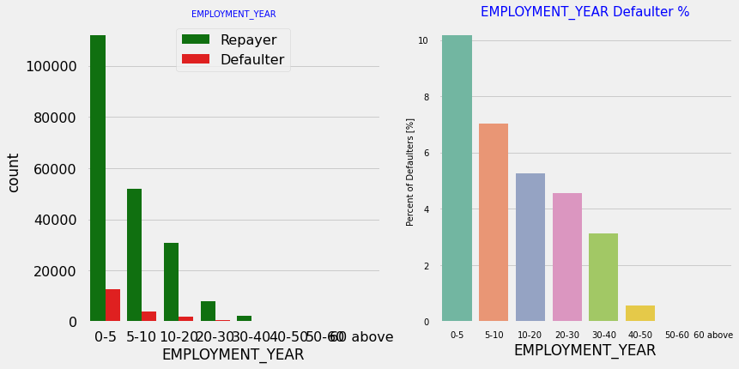
Target vs Employment Year:
Insights:
Majority of the applicants have been employed in between 0-5 years. The defaulting rating of this group is also the highest which is 10%
With increase of employment year, defaulting rate is gradually decreasing with people having 40+ year experience having less than 1% default rate

Slide 29
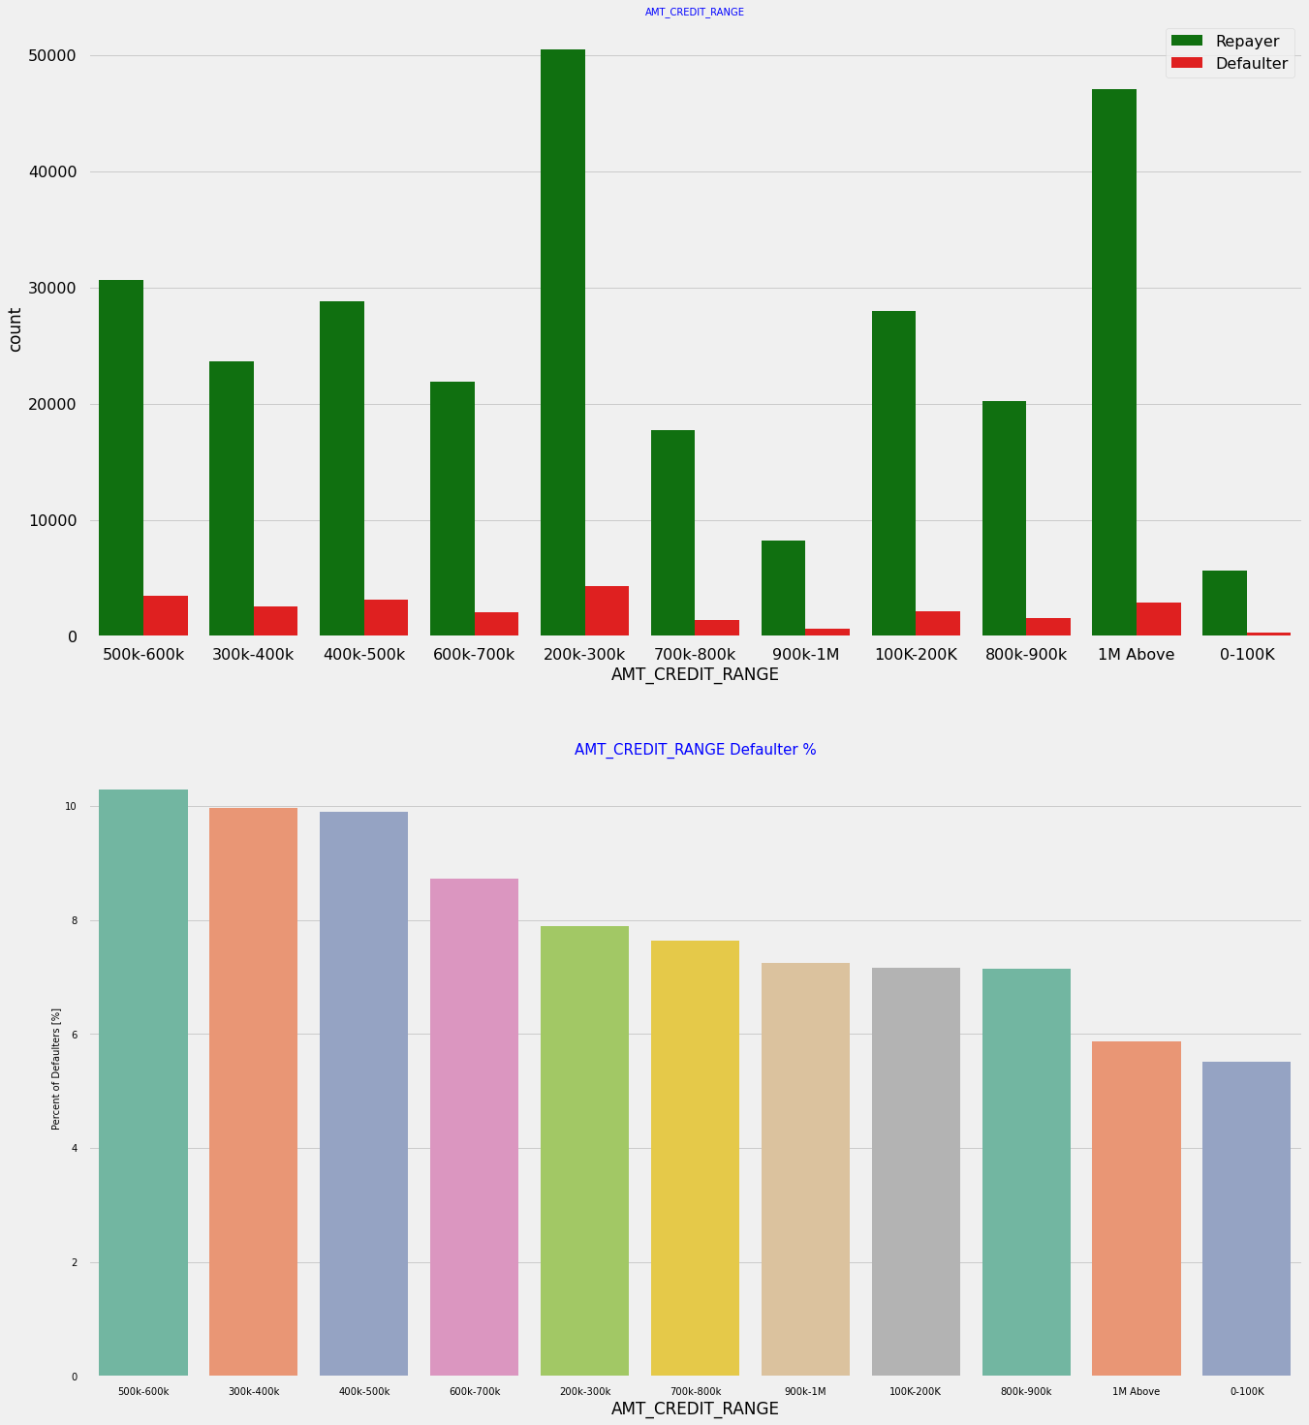
Target vs Amount Credit Range:
Insights:
More than 80% of the loan provided are for amount less than 900,000.
People who get loan for 300-600k tend to default more than others.

Slide 30
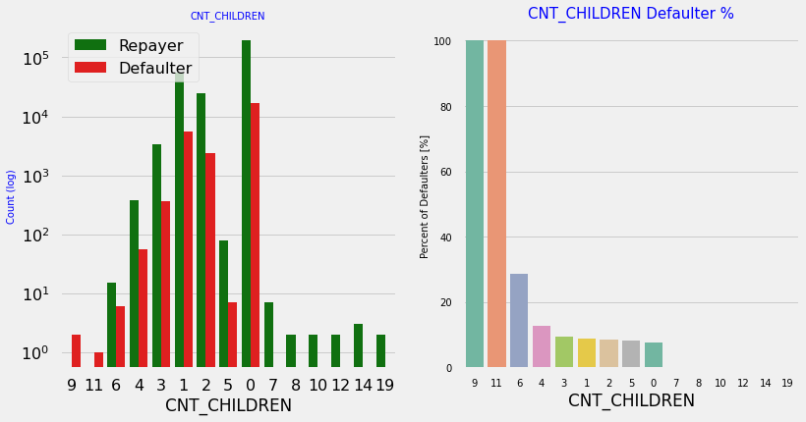
Target vs Children Count:
Insights:
Most of the applicants do not have children
Very few clients have more than 3 children.
Client who have more than 4 children has a very high default rate with child count 9 and 11 showing 100% default rate

Slide 31
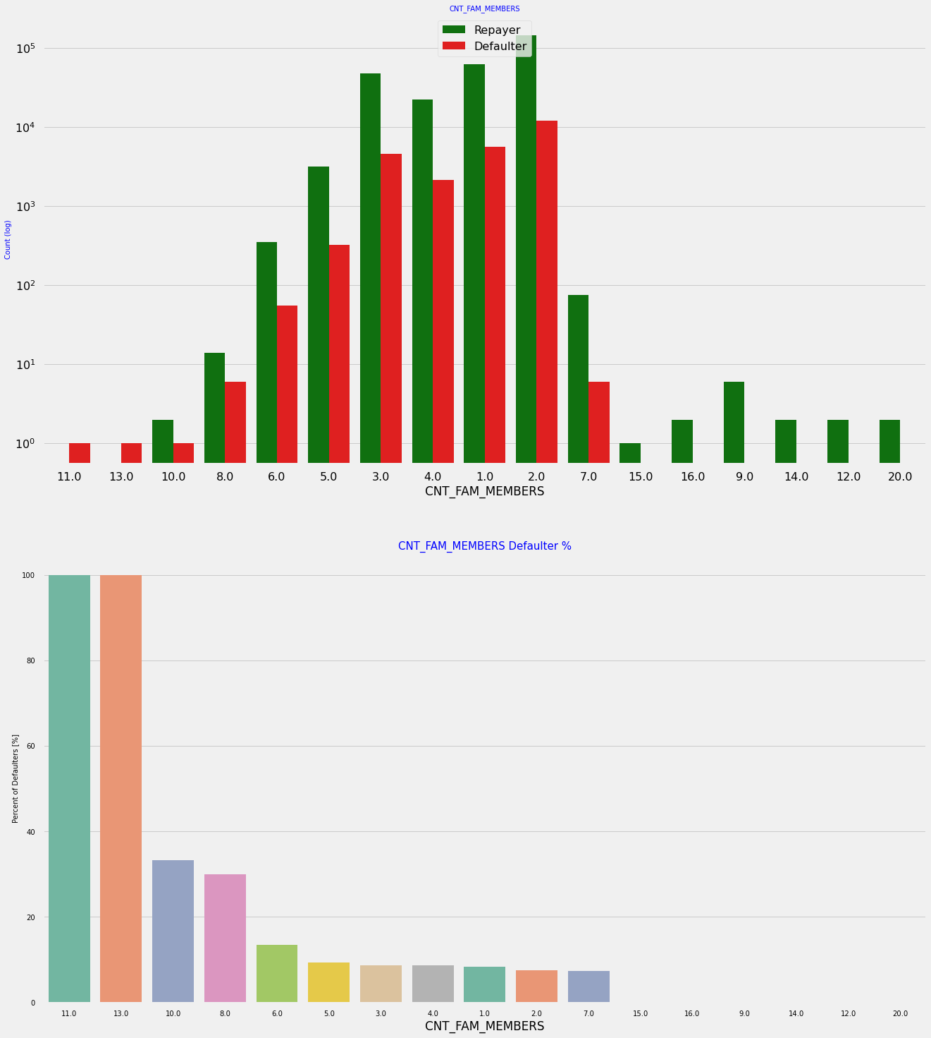
Target vs Family Members Count:
Insights:
Family member follows the same trend as children where having more family members increases the risk of defaulting

Slide 32
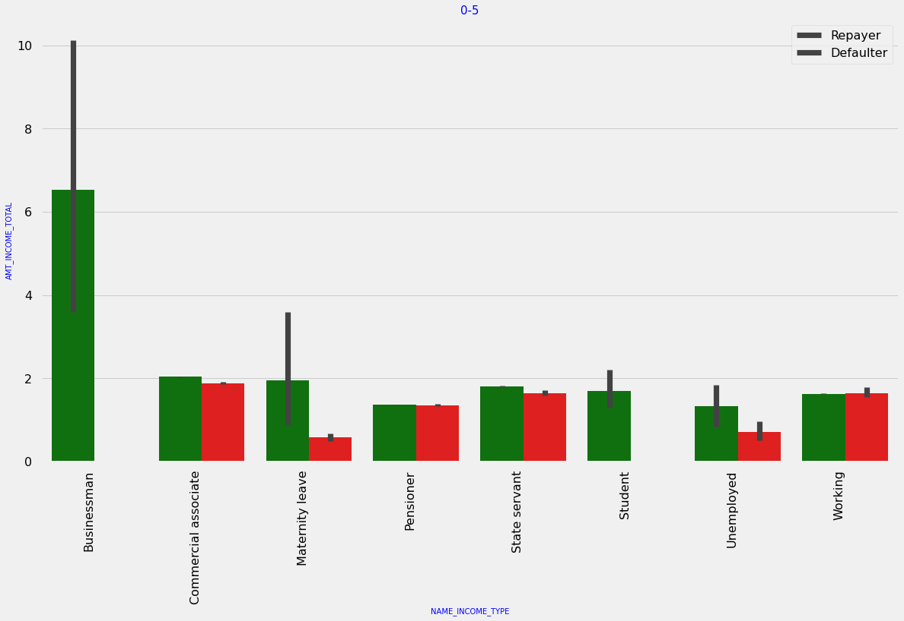
Bi variate Categorical Analysis.
Income Type, Total Income vs Target
Insights:
It can be seen that business man's income is the highest and the estimated range with default 95% confidence level seem to indicate that the income of a business man could be in the range of slightly close to 4 lakhs and slightly above 10 lakhs

Slide 33
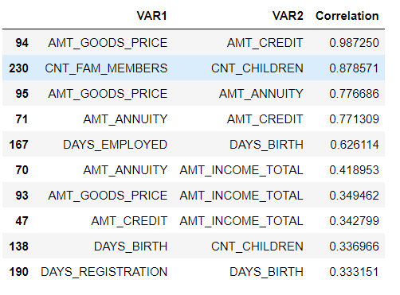
Top 10 Correlation between Numerical Attributes, Re-payers:

Slide 34
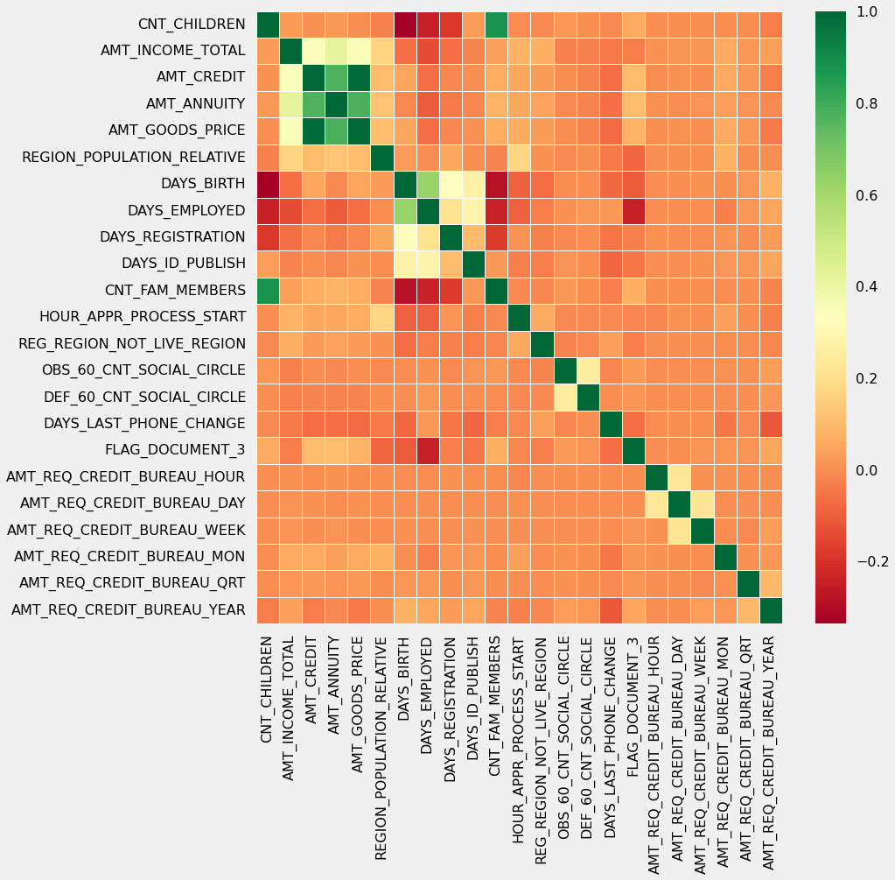
Correlation Heatmap of Re-Payers:
Insights:
Correlating factors amongst re-payers:
Credit amount is highly correlated with:
Amount of goods price.
loan annuity
total income
We can also see that re-payers have high correlation in number of days employed.

Slide 35
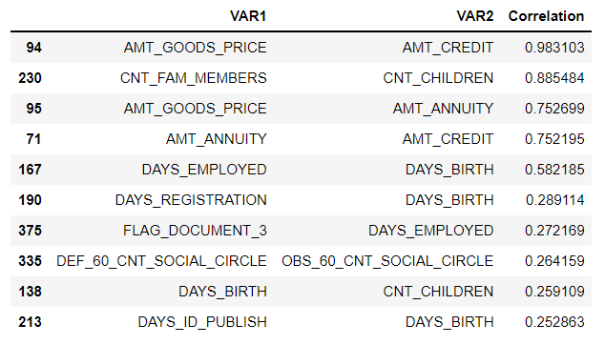
Top 10 Correlation between Numerical Attributes, Defaulters:

Slide 36
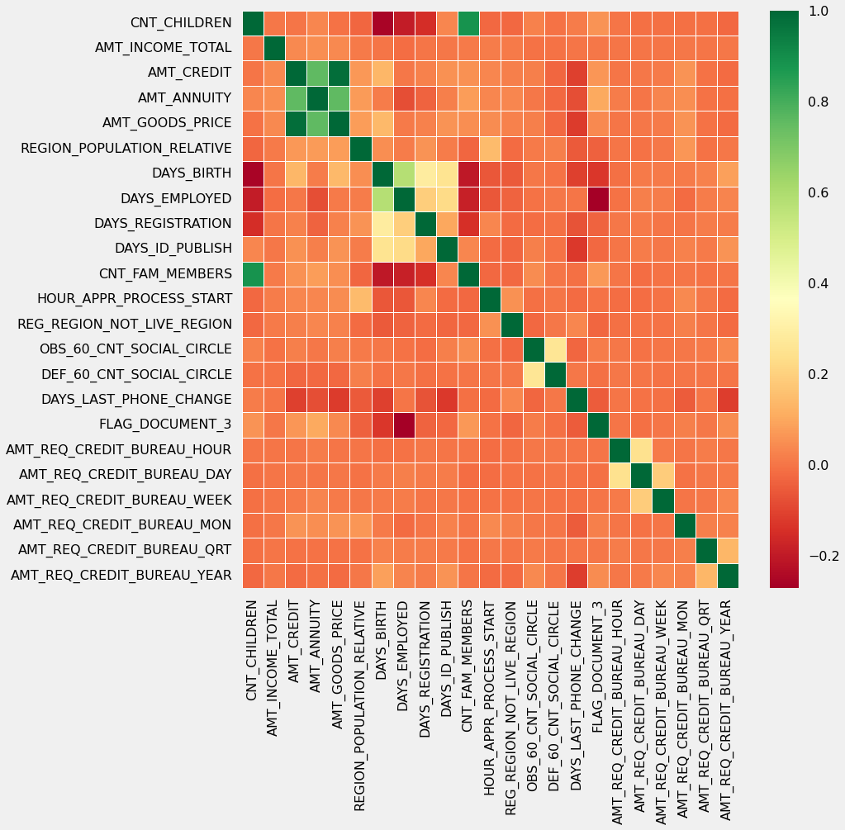
Correlation Heatmap of Defaulters:
Insights:
Credit amount is highly correlated with amount of goods price which is same as re-payers.
But the loan annuity correlation with credit amount has slightly reduced in defaulters(0.75) when compared to re-payers(0.77)
We can also see that re-payers have high correlation in number of days employed(0.62) when compared to defaulters(0.58).
There is a severe drop in the correlation between total income of the client and the credit amount(0.038) amongst defaulters whereas it is 0.342 among re-payers.
Days_birth and number of children correlation has reduced to 0.259 in defaulters when compared to 0.337 in re-payers.
There is a slight increase in defaulted to observed count in social circle among defaulters(0.264) when compared to re-payers(0.254)

Slide 37
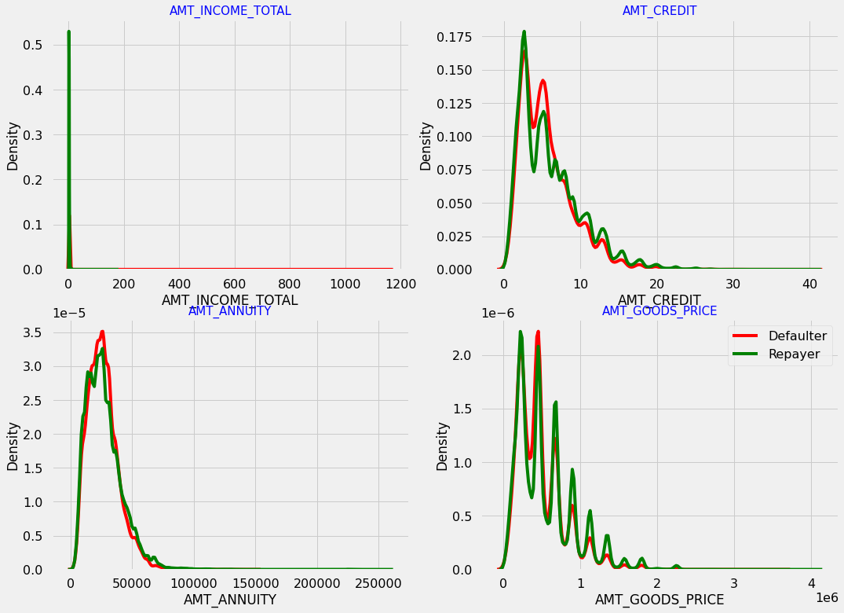
Numerical Univariate Analysis

Slide 38
Insights:
Most no of loans are given for goods price below 10 lakhs
Most people pay annuity below 50000 for the credit loan
Credit amount of the loan is mostly less then 10 lakhs
The re-payers and defaulters distribution overlap in all the plots and hence we cannot use any of these variables in isolation to make a decision

Slide 39
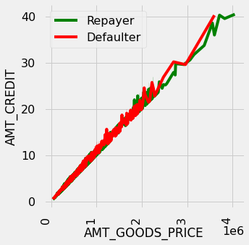
Target vs Goods Price, Credit:
Insights:
When the credit amount goes beyond 3M, there is an increase in defaulters.

Slide 40
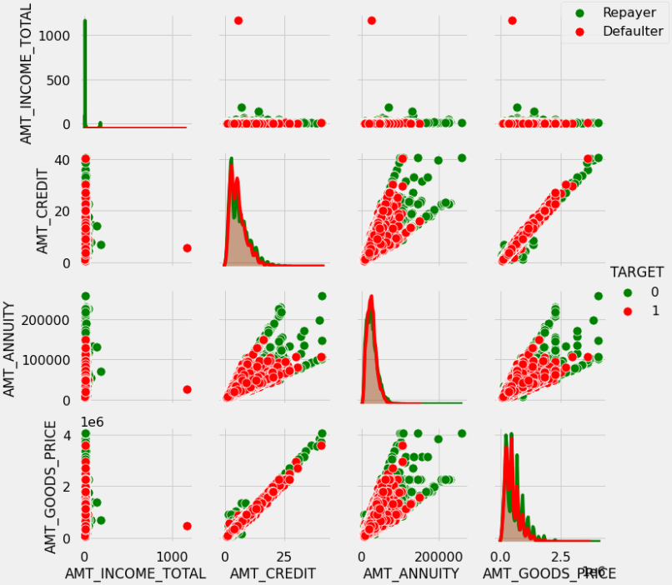
Amount Variable vs Loan Repayment Status:
Insights:
When amt_annuity >15000 amt_goods_price> 3M, there is a lesser chance of defaulters
AMT_CREDIT and AMT_GOODS_PRICE are highly correlated as based on the scatterplot where most of the data are consolidated in form of a line
There are very less defaulters for AMT_CREDIT >3M

Slide 41
Previous Dataset Analysis
Previous Dataset has 37 Columns
Dataset contains 1,670,214 rows
Dataset has missing values
We have applied all the steps which we have done with Application Dataset.

Slide 42
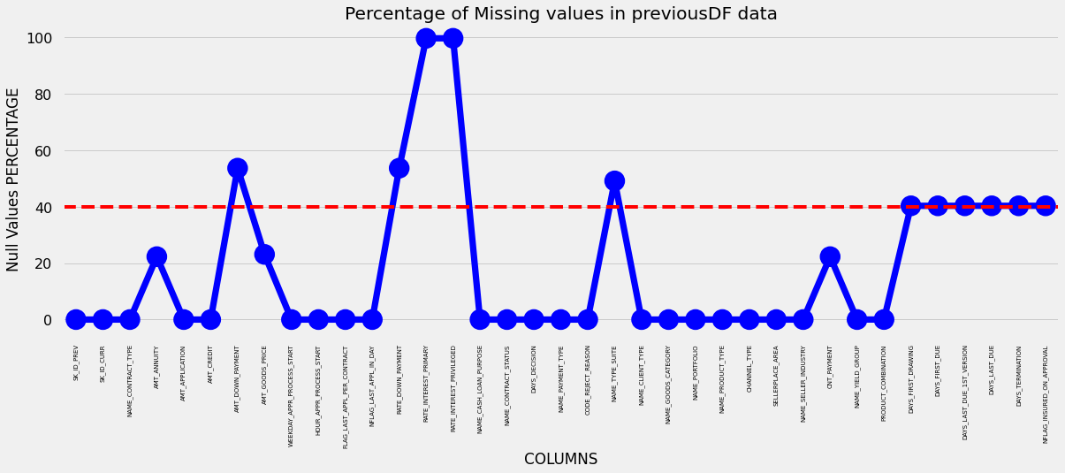
Percentage of missing values in previous Dataset.
Insights:
As we can see a red line on the above graph, columns above the red line are having null values more than 40% and below the red line are less than 40% missing values.

Slide 43
Imputing Null values
Strategy for Missing Values:
1. To impute null values in numerical column, we analyzed the loan status and assigned values.
2. To impute null values in continuous variables, we plotted the distribution of the columns and used
. median if the distribution is skewed
. mode if the distribution pattern is preserved.

Slide 44
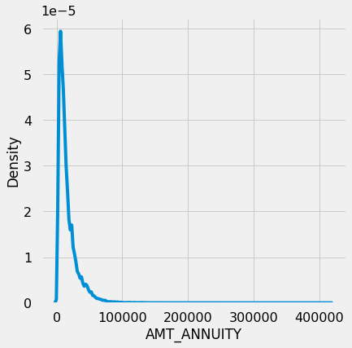
Column “ AMT_ANNUITY” Missing Values
Insight: There is a single peak at the left side of the distribution and it indicates the presence of outliers and hence imputing with mean would not be the right approach and hence imputing with median.

Slide 45
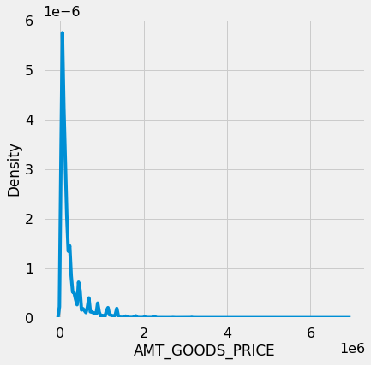
Missing Values filled with Median
Insights:
There are several peaks along the distribution. Let's impute using the mode, mean and median and see if the distribution is still about the same.

Slide 46
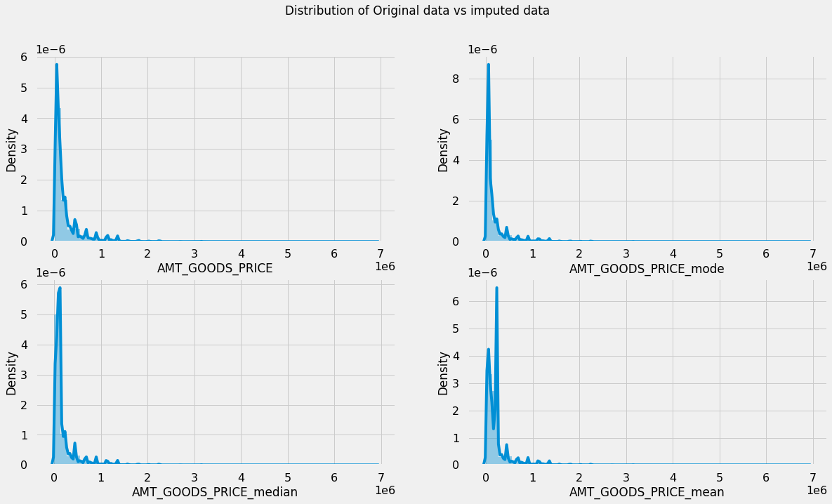
AMT_GOODS_PRICE Actual vs Imputed Data
Insight: The original distribution is closer with the distribution of data imputed with mode in this case

Slide 47
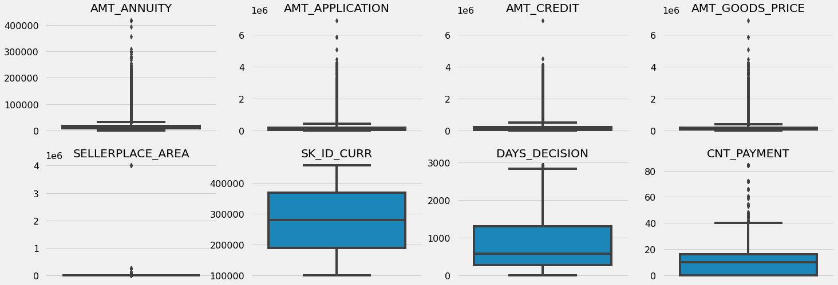
Identifying Outliers:
Insight: It can be seen that in previous application data
AMT_ANNUITY, AMT_APPLICATION, AMT_CREDIT, AMT_GOODS_PRICE, SELLERPLACE_AREA have huge number of outliers.
CNT_PAYMENT has few outlier values.
SK_ID_CURR is an ID column and hence no outliers.
DAYS_DECISION has little number of outliers indicating that these previous applications decisions were taken long back.

Slide 48
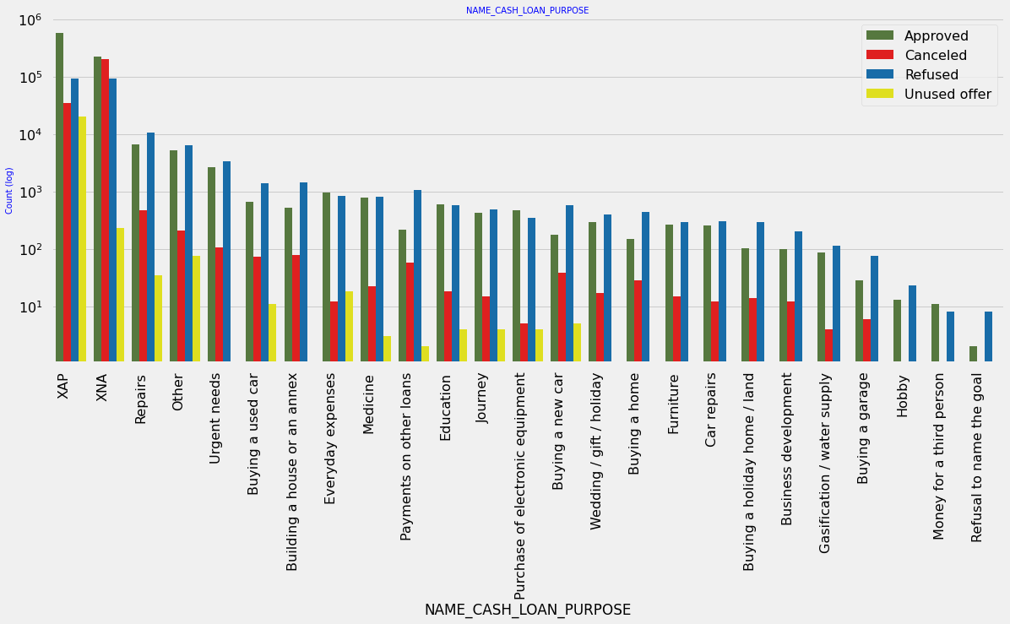
Plotting Contract Status vs purpose of the loan:

Slide 49
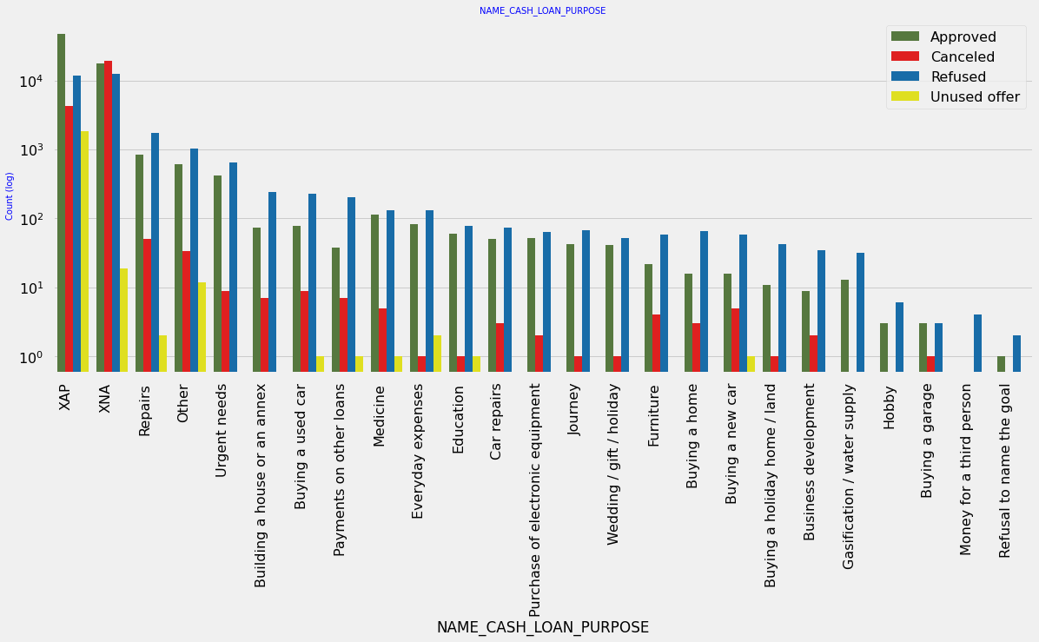
Inferences:
Loan purpose has high number of unknown values (XAP, XNA)
Loan taken for the purpose of Repairs seems to have highest default rate
A very high number application have been rejected by bank or refused by client which has purpose as repair or other. This shows that purpose repair is taken as high risk by bank and either they are rejected or bank offers very high loan interest rate which is not feasible by the clients, thus they refuse the loan.

Slide 50
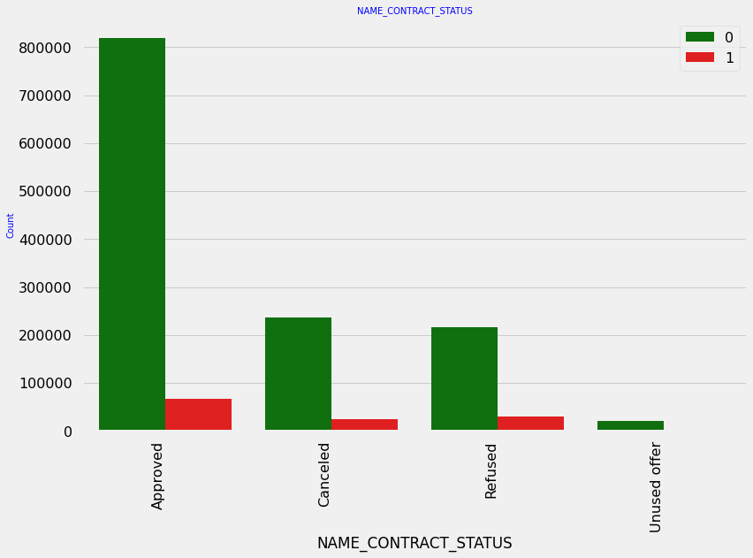
Contract Status
Inferences:
90% of the previously cancelled client have actually repaid the loan. Revisiting the interest rates would increase business opportunity for these clients
88% of the clients who have been previously refused a loan has paid back the loan in current case.
Refusal reason should be recorded for further analysis as these clients would turn into potential repaying customer.

Slide 51
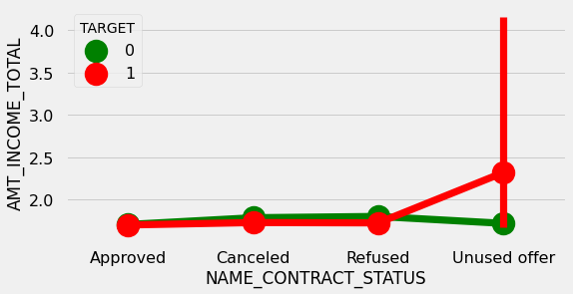
Total Income vs Contract Status
Inferences: The point plot show that the people who have not used offer earlier have defaulted even when there average income is higher than others.

Slide 52
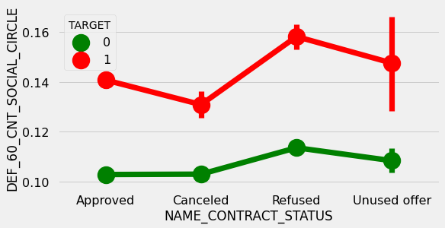
Defaulted in last 60 Days vs Contract Status
Inferences: Clients who have average of 0.13 or higher DEF_60_CNT_SOCIAL_CIRCLE score tend to default more and hence client's social circle has to be analyzed before providing the loan.

Slide 53

Conclusions.!

Slide 54
After analyzing the datasets, there are few attributes of a client with which the bank would be able to identify if they will repay the loan or not. The analysis is consisted as below with the contributing factors and categorization:
Decisive Factor whether an applicant will be Re-payer:
NAME_EDUCATION_TYPE: Academic degree has less defaults.
NAME_INCOME_TYPE: Student and Businessmen have no defaults.
REGION_RATING_CLIENT: RATING 1 is safer.
ORGANIZATION_TYPE: Clients with Trade Type 4 and 5 and Industry type 8 have defaulted less than 3%
DAYS_BIRTH: People above age of 50 have low probability of defaulting
DAYS_EMPLOYED: Clients with 40+ year experience having less than 1% default rate
AMT_INCOME_TOTAL:Applicant with Income more than 700,000 are less likely to default
NAME_CASH_LOAN_PURPOSE: Loans bought for Hobby, Buying garage are being repaid mostly.
CNT_CHILDREN: People with zero to two children tend to repay the loans.

Slide 55
Decisive Factor whether an applicant will be Defaulter:
CODE_GENDER: Men are at relatively higher default rate
NAME_FAMILY_STATUS : People who have civil marriage or who are single default a lot.
NAME_EDUCATION_TYPE: People with Lower Secondary & Secondary education
NAME_INCOME_TYPE: Clients who are either at Maternity leave OR Unemployed default a lot.
REGION_RATING_CLIENT: People who live in Rating 3 has highest defaults.
OCCUPATION_TYPE: Avoid Low-skill Laborers, Drivers and Waiters/barmen staff, Security staff, Laborers and Cooking staff as the default rate is huge.
ORGANIZATION_TYPE: Organizations with highest percent of loans not repaid are Transport: type 3 (16%), Industry: type 13 (13.5%), Industry: type 8 (12.5%) and Restaurant (less than 12%). Self-employed people have relative high defaulting rate, and thus should be avoided to be approved for loan or provide loan with higher interest rate to mitigate the risk of defaulting.
DAYS_BIRTH: Avoid young people who are in age group of 20-40 as they have higher probability of defaulting
DAYS_EMPLOYED: People who have less than 5 years of employment have high default rate.
CNT_CHILDREN & CNT_FAM_MEMBERS: Client who have children equal to or more than 9 default 100% and hence their applications are to be rejected.
AMT_GOODS_PRICE: When the credit amount goes beyond 3M, there is an increase in defaulters.

Slide 56
The following attributes indicate that people from these category tend to default but then due to the number of people and the amount of loan, the bank could provide loan with higher interest to mitigate any default risk thus preventing business loss:
NAME_HOUSING_TYPE: High number of loan applications are from the category of people who live in Rented apartments & living with parents and hence offering the loan would mitigate the loss if any of those default.
AMT_CREDIT: People who get loan for 300-600k tend to default more than others and hence having higher interest specifically for this credit range would be ideal.
AMT_INCOME: Since 90% of the applications have Income total less than 300,000 and they have high probability of defaulting, they could be offered loan with higher interest compared to other income category.
CNT_CHILDREN & CNT_FAM_MEMBERS: Clients who have 4 to 8 children has a very high default rate and hence higher interest should be imposed on their loans.
NAME_CASH_LOAN_PURPOSE: Loan taken for the purpose of Repairs seems to have highest default rate. A very high number applications have been rejected by bank or refused by client in previous applications as well which has purpose as repair or other. This shows that purpose repair is taken as high risk by bank and either they are rejected, or bank offers very high loan interest rate which is not feasible by the clients, thus they refuse the loan. The same approach could be followed in future as well.

Slide 57
Other suggestions:
90% of the previously cancelled client have actually repayed the loan. Record the reason for cancellation which might help the bank to determine and negotiate terms with these repaying customers in future for increase business opportunity.
88% of the clients who were refused by bank for loan earlier have now turned into a repaying client. Hence documenting the reason for rejection could mitigate the business loss and these clients could be contacted for further loans.

Slide 58


